Slide 1
CIS387/ECE387
Digital Forensics I
Windows Registry

Slide 2
Registry: A Wealth of Information
Registry
  A database that stores hardware and software configuration information, network connections, user preferences, and setup information
Lots of information, fairly difficult to “clean”
For investigative purposes, the Registry can contain valuable evidence
  Program installation information
  Recently accessed files
  User activities
  USB device history
To view the Registry, you can use:
  Regedit (Registry Editor) program
Notes:
Note: when you open control panel and toggle settings, that application actually updates the registries → equivalent of using Regedit program.
There are 5 root keys in windows.
H

Slide 3
Registry Definition
The registry is composed of two pieces of information:
  System-Wide Information
    Data about software and hardware settings. This information tends to be apply to all users of the computer.
  User Specific Information
    Data about an individual configuration. This information is specific to a user’s profile.
    User specific configuration will override system-wide software settings (i.e., task bar settings, color layout, font, etc.).

Slide 4
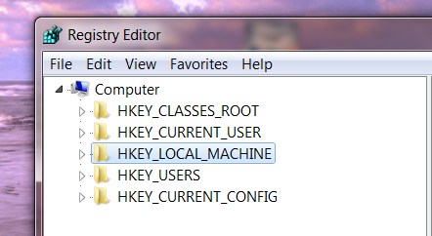
Exploring the Organization of the Windows Registry
HKEY
  Windows splits the Registry into categories with the prefix HKEY_
    Windows 9x have 6 HKEY categories
    Windows 2000 and later have 5 categories

Slide 5
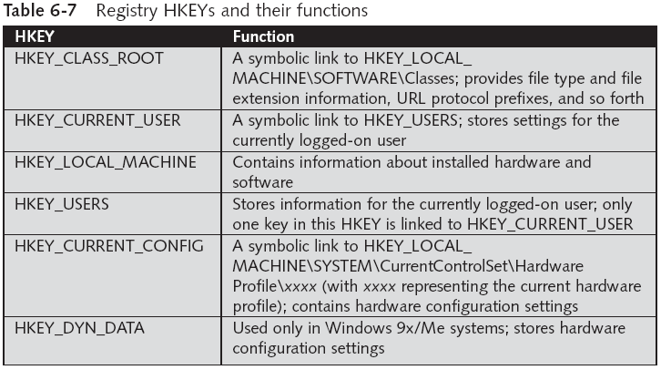
Exploring the Organization of the Windows Registry (continued)
Notes:
Only HKEY_LOCAL_MACHINE and HKEY_USERS are stored on harddrive; the other 3 registry keys are volatile and generated from the other two keys (so when you shut down machine, the other 3 registries are lost, but they are permanently stored on the non-volatile, harddrive-stored registries.
When system boots, the other 3 keys are generated from the 2 hard drive keys, combing and overriding settings as needed (for example, user key config files will override the default config file settings stored on local machine key).
Note: HKEY_CURRENT_USERS key (volatile) is linked under HKEY_USER directory and is generated when a user logs in.
Each of these HKEYs plays an important role in the function of the system.
The USERS hive stores all the actively loaded user profiles for that system (including configuration settings for all programs for the given user).
CURRENT_USER is the active, loaded user profile the currently logged-on user.
Local_Machine contains a vast array of config infor for the system, including hardware and software settings.
Current_Config contains hardware profile the systems users at startup.
Class_Root contains config info relating to which application is used to open various files on the system. Is sub-classed to both Current_user and Local_Machine.

Slide 6
Registry Organization
A Registry Hive is a group of Keys, subkeys, and values stored in a single file on the disk (hivelist under hivelist directory inside of one of the directories of LOCAL MACHINES key); stores key (directory) value (data associated with the key or subkey in a raw file) pairs.
Hives are stored in a variety of files that are dependent on the Windows Operating System that is being utilized.
Notes:
Each registry (database file) is a (key, value) pair → key is always a string and it refers to a directory name, value could be strings, 4-byte integers, or binary value.
NTUser.dat and UsrClass.dat are stored in each user’s own user directory.
Registry hive is basically file system for registry keys and the data all in one file.
Note: each key could be a file or other directory (called subkey).

Slide 7
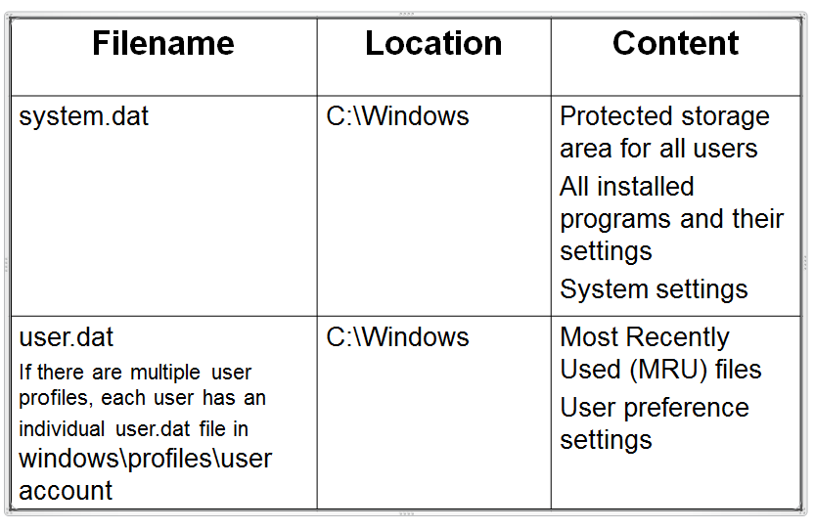
Windows 9x Registry
Filename | Location | Content
system.dat | C:\Windows | Protected storage area for all users All installed programs and their settings System settings
user.dat If there are multiple user profiles, each user has an individual user.dat file in windows\profiles\user account | C:\Windows | Most Recently Used (MRU) files User preference settings

Slide 8
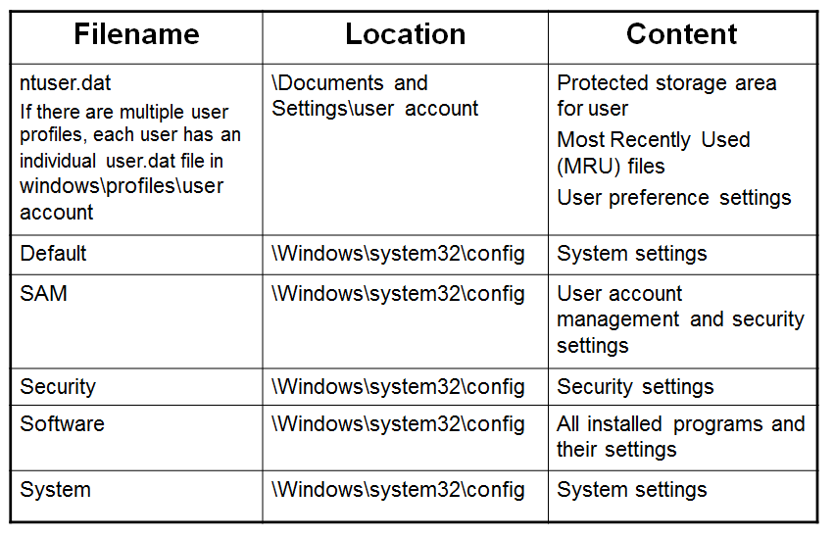
Windows XP Registry

Slide 9
User’s Profile Hives
NTUSER.DAT (mounted on HKEY_CURRENT_USER when a user logs in)
USRCLASS.DAT (mounted on HKEY_CURRENT_USER\Software\CLASSES)
  located in the directory C:\Users\<username>\AppData\Local\Microsoft\Windows

Slide 10
Note, not all on hard disk
Some Registry paths are volatile and do not exist in files on the hard drive
  Created during system startup and are not available when the system shuts down
    E.g., HKEY_LOCAL_MACHINE\Hardware, HKEY_LOCAL_MACHINE\System\Clone
To examine data in volatile hives
  either exporting the entire volatile hive to a .reg file via regedit.exe,
  or employing some other tools to collect the data before shutting down the system
Notes:
The HKEY_LOCAL_MACHINE HARDWARE registry key contains hardware data recreated during each system startup. This data includes information about the devices on the motherboard and the data on the IRQs used by individual device drivers.
This means that the settings are computed and recreated each time the system starts up, and are lost when you shut the system down. All drivers and applications use this subtree for obtaining information on system components and for storing the data directly under the DEVIC.MAP subkey and indirectly under the RESOURCEMAP subkey
The Clone subkey is built during system startup and contains a temporary copy of the control set that is being used to start the computer. When Winlogon reports that the startup was successful, the Clone subkey becomes the LastKnownGood control set.
This subkey is a non-accessible section that holds duplicate information for use by the system in case of failure. This key is saved with RDISK.EXE and activated by Last Known Good, and points to the %SYSTEMROOT%\Repair directory.

Slide 11
Registry Structure Within a Hive File
Key
  Each HKEY contains folders referred to as keys
  Keys can contain other folders or values
Subkey
  A key displayed under another is a subkey, like a subfolder in Windows Explorer
Branch
  A key and its contents, including subkeys, make up a branch in the Registry
Value
  A name and value in a key
  Similar to a file and its data content
Default value
  All keys have a default value that may or may not contain data
Notes:
Note all keys/subkeys have a default value (which may have a no value set by default).

Slide 12
System Information
In live investigation, right-click My Computer->Properties
In postmortem analysis, system info is available in Registry
  Most are maintained primarily in the System and Software hives (some in the Security hive file)
  User information is maintained in the SAM hive file
  Information specific to users and their activity is maintained in the user’s NTUSER.DAT file
Notes:
System: contains additional computer system settings
Software: contains installed programs settings and associated usernames and passwords
Security: contains the computer’s security settings
You can edit registry via control panel = safe; editing registry files directly is dangerous and could corrupt system so make sure you know what you are doing.

Slide 13
CurrentControlSet
A control set contains system configuration info such as device drivers and services
CurrentControlSet is a volatile portion of the Registry
  You won’t find it in an acquired image
A subkey of HKEY_LOCAL_MACHINE\System
Info you can get:
  ComputerName
    HKEY_LOCAL_MACHINE\System\CurrentControlSet\Control\ComputerName\ActiveComputerName
  TimeZoneInformation
    Very important for establishing a timeline of activity on the system
    HKEY_LOCAL_MACHINE\System\CurrentControlSet\Control\TimeZoneInformation
  Network Interfaces, etc.
  ...
Notes:
A control set contains system configuration information such as device drivers and services. You may notice several instances of control sets when viewing the Registry. Some are duplicates or mirror images of others and some are unique. This article describes how to find control sets, which ones are important, and why.
Control sets are stored in the HKEY_LOCAL_MACHINE subtree, under the SYSTEM key. There may be several control sets depending on how often you change system settings or have problems with the settings you choose. A typical installation of Windows NT will contain four:\ControlSet001
\ControlSet002
\CurrentControlSet
\Clone
ControlSet001 may be the last control set you booted with, while ControlSet002 could be what is known as the last known good control set, or the control set that last successfully booted Windows NT. The CurrentControlSet subkey is really a pointer to one of the ControlSetXXX keys. Clone is a clone of CurrentControlSet, and is created each time you boot your computer by the kernel initialization process. In order to better understand how these control sets are used, you need to be aware of another subkey, Select.
Current control set is stored on harddrive.
Registry files are how all other apps to access the same data to know the default system configuration settings (for example, application color scheme).

Slide 14
CurrentControlSet (continued)
HKEY_LOCAL_MACHINE\System\CurrentControlSet\Services
  System boot info
  Services set to start automatically (start value 0x02) are launched
HKEY_LOCAL_MACHINE\System\CurrentControlSet\Enum\USBSTOR
  When a USB is connected to a Windows system, footprints or artifacts are left in the registry
  Once the device is identified, a Registry key is created

Slide 15
Data types for value in (key, value) pairs
REG_SZ = string
REG_Binary = binary
REG_DWOD = 4-byte integer
Root keys (the 5 main directories) contains subkeys (subdirectories) and (keyname,value) pairs. All of these are referred to as “keys”. The raw data file key contains the (key=filename/keyname, value=binary, string, 4-byte data format) pair.

Slide 16
Enum key
Under currentcontrolset key
Contains USB and USBSTOR subkey information which contains a list of devices connected from any usb port → even if not connected; the footprint of the device is stored in this key.
Very important for forensic investigations.
Drives have a physical address (like MAC address); OSes make use of this for plug and play (to lookup a device in the registry to see if the driver is already installed for the device so that the OS can interface and control I/O with the device.
Driver software often stored on usb device.

Slide 17
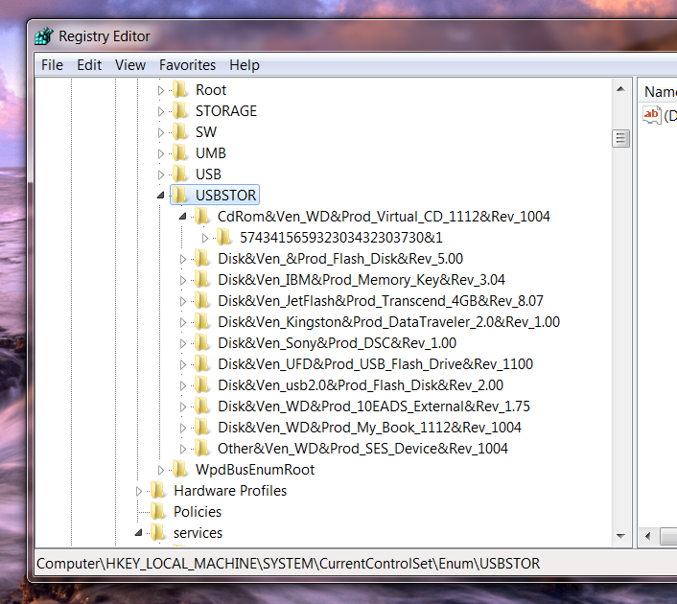

Slide 18
MRU
To identify the Most Recently Used (MRU) files on a suspect computer system:
  Windows 9x/Me
    User.dat
  Windows NT/2000
    Ntuser.dat
  Windows 10
    HKEY_CURRENT_USER\SOFTWARE\Microsoft\Windows\CurrentVersion\Explorer\RecentDocs
    Select file extension and select item
Notes:
Search should be made for MRU, LRU, Recent
Under HKEY_USERS key, search for RecentDocs subkey
For example, when you open Microsoft Word, and go to open recent → the application uses these registry keys to find this information.
Recent docs contains subkeys for every file type (extension) that was accessed and keeps track of last 20 files (20 data keys) for that file type; value=binary, and it is the binary of the filename(UTF-16).

Slide 19
Registry Forensics
Registry keys have last modified time-stamp
  Stored as FILETIME structure
    like MAC for files
  Not accessible through reg-edit
  Accessible in binary.

Slide 20
Registry Forensics
Registry Analysis:
  Perform a GUI-based live-system analysis.
    Easiest, but most likely to incur changes.
    Use regedit.
  Perform a command-line live-system analysis
    Less risky
    Use “reg” command.
  Remote live system analysis
    regedit allows access to a remote registry
    Superscan from Foundstone
  Offline analysis on registry files (safest analysis for reading hivelist files).
    Encase, FTK (Access data) have specialized tools
    regedit on registry dump.
Notes:
Remember: hivelist files make it easier to see all keys, subkeys, and (key,value) pair keys with ease → but file is a binary, so you need a tool to read the file appropriately, such as FTK or Autopsy.

Slide 21
Registry Forensics: NTUSER.DAT
AOL Instant Messenger
  Away messages
  File Transfer & Sharing
  Last User
  Profile Info
  Recent Contacts
  Registered Users
  Saved Buddy List

Slide 22
Registry Forensics: NTUSER.DAT
ICQ
  IM contacts, file transfer info etc.
  User Identification Number
  Last logged in user
  Nickname of user

Slide 23
Registry Forensics: NTUSER.DAT
Internet Explorer
  IE auto logon and password
  IE search terms
  IE settings
  Typed URLs
  Auto-complete passwords

Slide 24
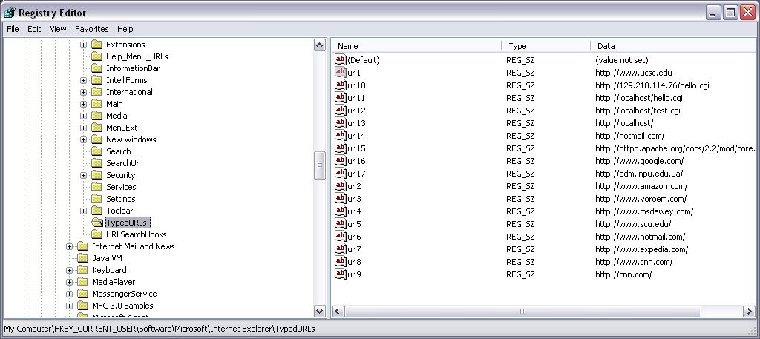
Registry Forensics: NTUSER.DAT
IE explorer Typed URLs

Slide 25
Registry Forensics: NTUSER.DAT
MSN Messenger
  IM groups, contacts, …
  Location of message history files
  Location of saved contact list files

Slide 26
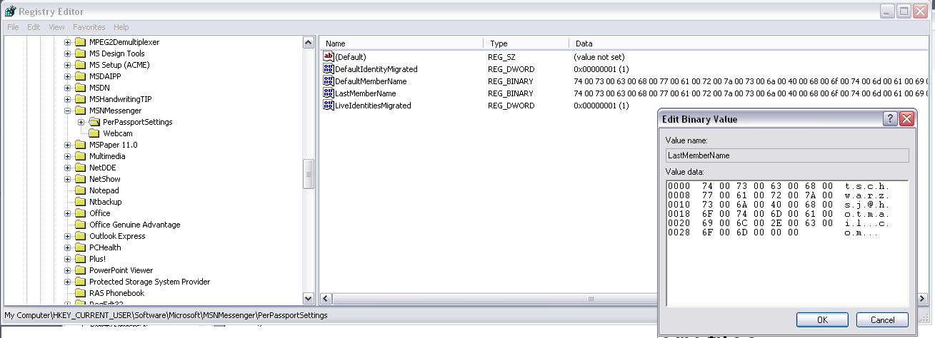
Registry Forensics: NTUSER.DAT
Last member name in MSN messenger

Slide 27
Registry Analysis
A number of locations within the Registry contain info pertinent to most investigations. Other locations contain information pertinent to specific types of investigations, such as intrusions, fraud, etc.
Some specific Registry keys and values can be of importance, but often it is the correlation of several Registry keys and values that can provide the most complete picture

Slide 28
Outline
Windows Registry
Other useful files with forensic content

Slide 29
Windows Recycle Bin
Indirect file deletion facility
Mimics functionality of a trash can
  Place “garbage” into the can
  You can change your mind about the “garbage” and remove it, until…
  …trash is emptied, then it’s “gone”
Files are moved into a special directory
Deleted only when user empties

Slide 30
Windows Recycle Bin: Closer Look
In Win2K/XP, \RECYCLER
In 95/98, \RECYCLED
On dragging a file to recycle bin:
  File entry deleted from directory
  File entry created in recycle bin directory
  Data added to INFO/INFO2 file in the recycle bin
INFO file contains critical info, including deletion time!
Presence of deletion info in INFO file generally indicates that the file was intentionally deleted

Slide 31
INFO file: Closer Look
INFO file format is binary, but format is known
For each file in the recycle bin, contains:
  Original pathname of file
  Time and date of file deletion
  New pathname in the recycle bin
  Index in the recycle bin
    Can be used to establish the order in which files were deleted
Popular commercial forensics packages correctly parse INFO files
  e.g., Encase, FTK

Slide 32
Windows Shortcut Files
In Desktop, Recent, etc. directories
*.lnk files
Give information about configuration of desktop
Existence of desktop shortcuts (even if the shortcut files are deleted) can…
  establish that user knew of the existence of the files
  establish that user organized files
e.g., can be used to dismiss claims that child pornography or illegal copies of software were “accidentally” downloaded in a bulk download operation
Notes:
Similar to Linux soft link
It is an independent file, and its contents store a pointer to location of another file.

Slide 33
Windows Swap Files
Supports Windows virtual memory system
Contains swapped out pages corresponding to executing processes
NT, Win2000, XP
  Generally, c:\pagefile.sys
  Hidden file
95/98
  c:\windows\win386.swp
  Hidden file
Notes:
Allows paging functionality (as learned in CIS-450)

Slide 34
Windows Swap File: Overview
Potentially, contains a lot of junk
File carving or keyword searches against the raw disk will yield a superset of the information in the swap file (obviously)
May be useful to target swap file directly, particularly on large drives
Careful!
Keyword matches against the swap file DO NOT necessarily mean that the corresponding strings were in pages swapped out during the last boot! (could be pages from a previous boot RAM memory image)
When the swap file is created, the “underlying” blocks aren’t cleaned
As the swap file is reused, not all blocks are cleaned
Blocks may not be overwritten even during months of use!
Notes:
Depending on the version of Windows being used, WIN386.SWP and Pagefile.sys are the files that Windows uses to move information from the hard drive to RAM memory and then back to the hard drive. Swap files contain recent computer activity, files of all kinds, and graphic images, etc. The Windows swap file allows a computer to operate as if it has more installed memory that it does in reality -- called "virtual memory." By means of this data swapping activity, the computer uses hard disk space as a place to swap information back and forth as the processor is running computer applications. A portion of the hard disk is used for memory operations. The data in the swap file can come from any application and may remain on the disk in the swap file for long periods of time. The swap file expands and contracts in size while Windows is running. The maximum size is roughly 4 gigabytes. At shutdown the size is reduced to approximately half the size of the installed RAM memory. Data may still exist in the swap file though totally expunged elsewhere on the computer. It may also exist in the form of older versions of the swap file discarded or abandoned to unallocated space. The swap file can be searched with Data Sniffing software which extracts different kinds of user files contained inside the much larger swap file.

Slide 35
Hibernation Files
hiberfil.sys: memory image of OS, created at shutdown
Allows fast restart
Hibernation file locked during OS execution
Approximately the size of physical RAM (e.g., 2GB RAM == ~2GB hibernation file)
Potentially much more interesting than swap file, since it allows the last “on” state of the machine to be recreated

Slide 36
Hibernation (2)
Can search hibernation file for interesting strings, including URLs, passwords, etc.
First block of file is zero-filled after boot, so you get one chance to “boot” the machine again, unless you have a backup of the hibernation file
Remainder of hibernation file remains unchanged until another hibernation event occurs…
Means that you may be able to recover interesting information that is quite old

Slide 37
Windows Print Spool Files
*.spl, *.shd files
.shd file contains information about the file being printed (basically meta data)
.spl file contains info to render the contents of the file to be printed (actual file data contents)
Presence of .shd files can be used in a similar fashion as for shortcut files…
…shows knowledge of existence of files and a deliberate attempt to access (print) the contents of the file
Notes:
.spl is basically an image file of the original data contents to be printed (imaged in a format that a printer can use and also used to keep users print jobs separate) → .spl and .shd files are the files used in the spool process that allows for the print spool service (functionality).

Slide 38
Summary
Windows Registry
  A rich set of information about the system and user activity
  Portions of the Registry are volatile
  Registry keys (and some values) have time stamps associated with them that can be used in timeline analysis
    The Registry can be considered a log file
Other useful files of forensic interest
  Recycle bin
  Shortcut files
  Swap files
  Hibernation files
  Print spool files

